Slide 1

Global Project
Germany VS
By: Gabriella Reckley and

Slide 2

Population
Germany:
The population of Germany for 2024 is 83,809,425 people. Which is a 0.06% increase from last year.

Slide 3

Demographics

Slide 4

Languages Spoken
Germany:
German is the most used language but there are some minority languages like Danish, Frisian, Sorbian, and Romani
Both:

Slide 5

Climate:
Germany:
Germany is favored with a generally temperate climate, especially in view of its northerly latitudes and the distance of the larger portions of its territory from the warming influence of the North Atlantic Current. Extremely high temperatures in the summer and deep, prolonged frost in the winter are rare.

Slide 6

Technology Uses
Germany is known for its technological advancements with research and developing efforts that form an integral part of the country’s economy. The raw output of scientific research from Germany consistently ranks among the world’s highest.

Slide 7

Technology Culture
Germany:
Germany has been an academic powerhouse for a long time, and as such education is the backbone of Germany’s technological advances. According to The Federal Ministry of Education and Research, “the goal is for good ideas to be translated quickly into innovative products and services. This is because innovative solutions are the factors that drive our prosperity and support our quality of life.”

Slide 8
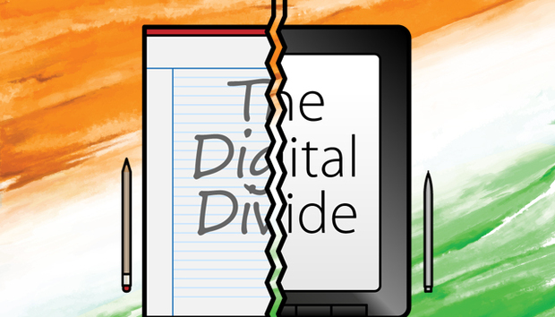
Digital Divide
Germany:
There are several factors that contribute to the digital divide in Germany. Like age, gender, family structure, education, ethnicity, and motivation. Also, in rural areas struggle with internet access so different places will progress differently.

Slide 9
Sources:
How do they do it in Germany? By Teachers TV/UK Department of Education, 2008. CCBC Libraries / All (ccbcmd.edu)
CCBC Libraries / All (ccbcmd.edu) Land art as climate action by Munuch: Hirmer, [2023]
Why Is Germany A Powerhouse In Research And Innovation? (theculturetrip.com) Culture Trip [2024]

